Slide 1

Hybrid Mutual Fund
An alpha of mixing Assets

Slide 2
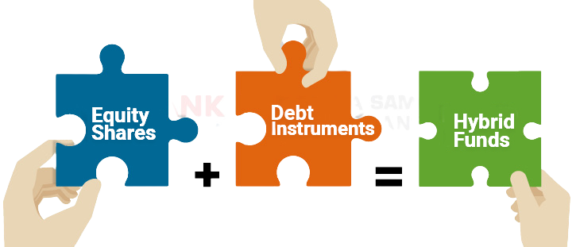
Hybrid Mutual Fund
An Alpha of Mixing Assets

Slide 3


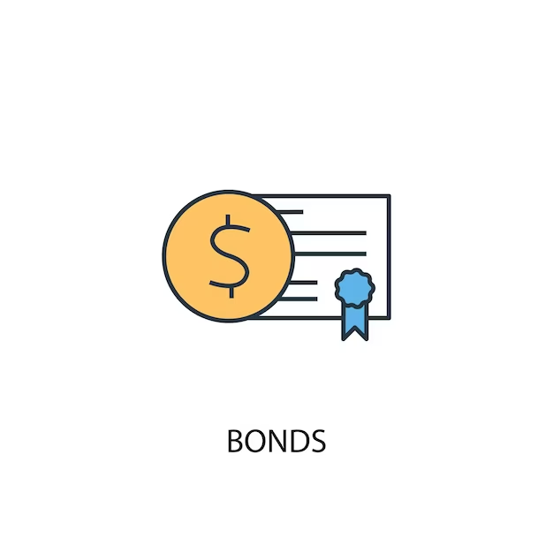

Asset classes are uncorrelated
Asset combinations vary to achieve specific financial goals and optimize returns.
.
One asset may perform well, while another may not do as well.
STOCKS
BONDS
GOLD
REAL ESTATE
ETC……

Slide 4
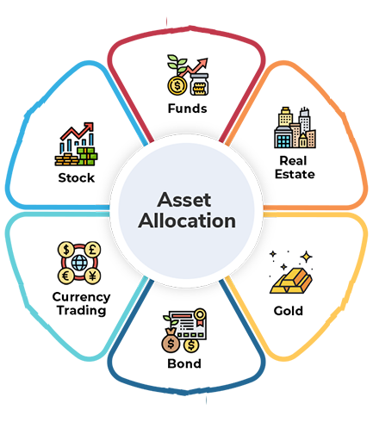
Advantage of having Multi-Asset
Diversifying across various assets helps hedge against equity volatility.
It has potential to beat inflation.
It may lower drawdowns.
Hybrid investment helps provide stability.
Reducing volatility boosts investor’s confidence.

Slide 5
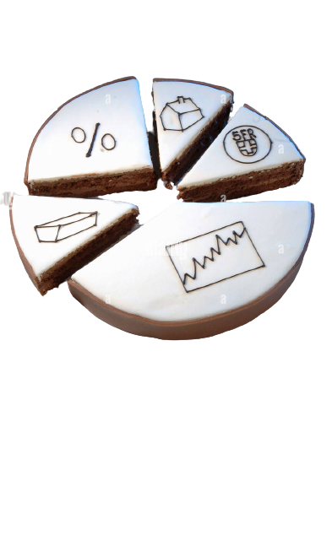
Universal combination
Asset allocation has been consistently effective in All conditions
Asset allocation diversifies investments across various asset classes, like stocks, bonds, and more.
Adapting the allocation mix helps investors navigate market volatility.
Diversification spreads risk and lessens market impact.

Slide 6
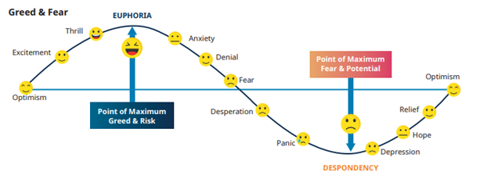
Universal combination
Asset allocation has been consistently effective in All conditions
It succeeds in all market cycles, including bulls and bears.
The strategy is founded on timeless risk management principles.

Slide 7

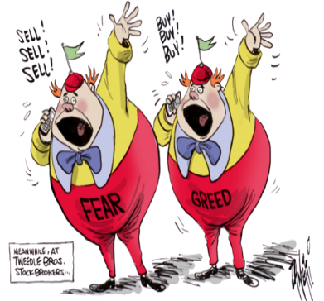
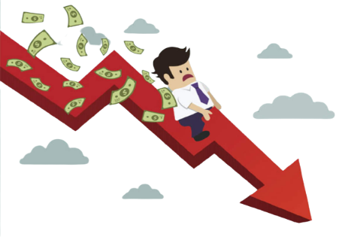

Impatience
Investors Behavior
Fear & Greed
Mis-timed investment transactions
Knowledge gap

Slide 8
Hybrid Mutual Fund
Hybrid Mutual Fund
Impatience
Solution
Fear & Greed
Mis-timed investment transactions
Knowledge gap
Hybrid Mutual Fund
Hybrid Mutual Fund

Slide 9
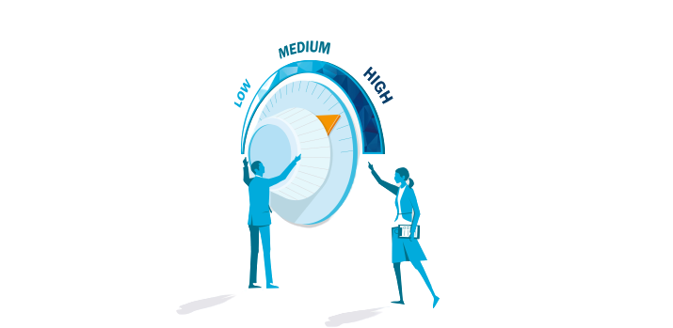

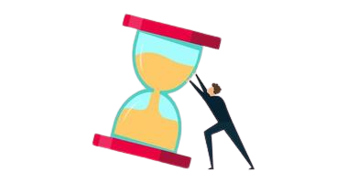

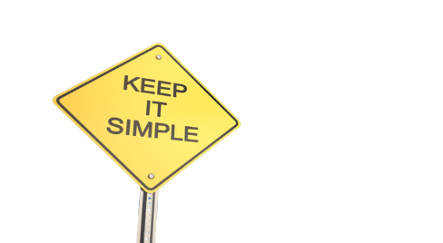
Risk Management
Risk management is not the investor's cup of tea. Why??
Risk Tolerance Variability
Due to lack of expertise
Lack of Time and Efforts
Preference for Simplicity
Emotional Factors

Slide 10
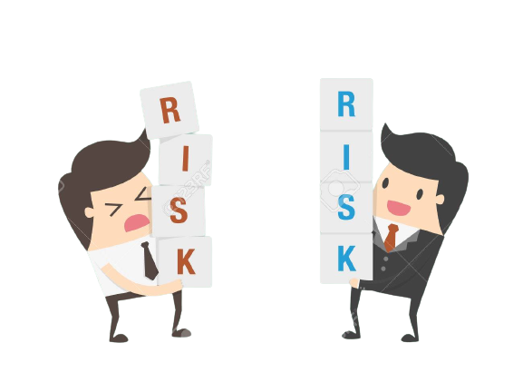
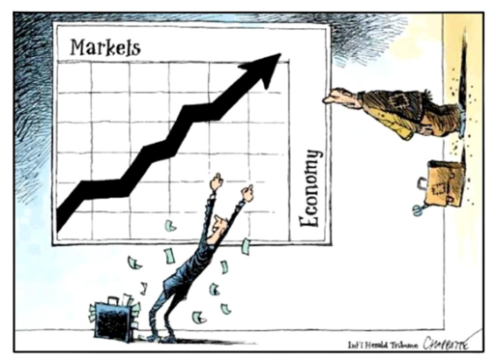


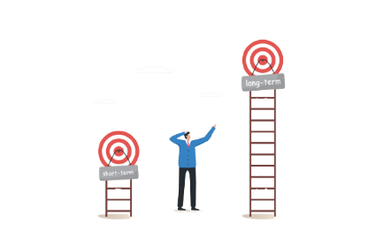
Hybrid MF’s In-built Risk Management
Risk Management involves taking timely, well-calculated risks
Strategic risk management
Market timing
Research and Information
Alignment with Goals
Long-Term and Short-Term Perspectives

Slide 11


Importance of being Balanced in life
Do you Prefer?
Work life Balance
Balanced Diet

Slide 12

Importance of being Balanced in life
Why not consider a balanced portfolio?

Slide 13
Importance of being Balanced in life
A balanced portfolio is a wise strategy for financial stability.
A balanced portfolio may reduces emotional stress from risky investments.
A balanced portfolio can promote mental well-being alongside financial stability.
With a diversified portfolio, Investors aim for financial security and peace of mind.

Slide 14

“I should have computed the historical co-variances of the asset classes and drawn an efficient frontier. Instead, I visualized my grief if the stock market went way up and I wasn’t in it – or if it went way down and I was completely in it. My intention was to minimize my future regret. So I split my contributions between bonds and equities.”
Harry Markowitz
1990 Nobel Prize recipient in economic science for developing the Model Portfolio Theory.

Slide 15
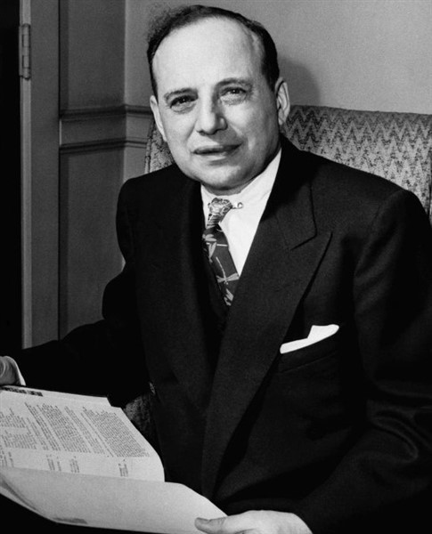
Bejamin Graham
Known as the father of Value Investing
He has also created the model of mixing equity and debt asset class in appropriate scenario & investors.

Slide 16
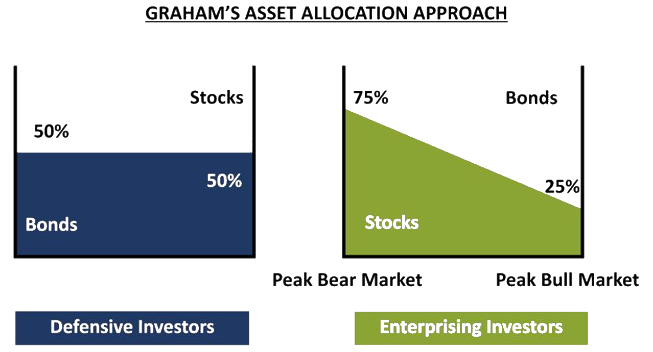

Slide 17
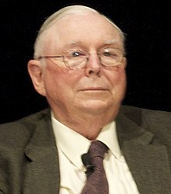
Simple ≠ Easy
“More investors don’t copy our model because our model is too simple […]. Most people believe you can’t be an expert if it’s too simple.”
Charles Thomas Munger, vice chairman of Berkshire Hathaway
"Simple doesn't mean easy" serves as a reminder that while something may seem straightforward or uncomplicated in theory, its execution or mastery can be quite challenging and may require “ effort, time, and persistence “.

Slide 18

Thank You

